Slide 1
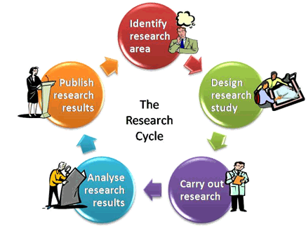
Program of Graduate Training
Jia Wei Chang

Slide 2
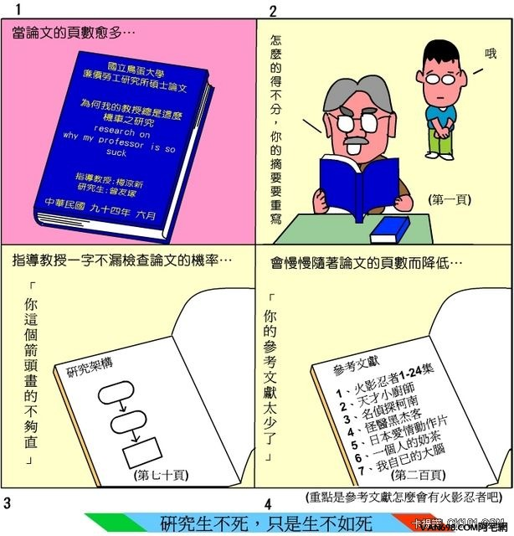
一樣都是過兩年，請做好覺悟，恪守本分、積極認真。兩年一到就請你乖乖畢業！加油，好嗎！？

Slide 3
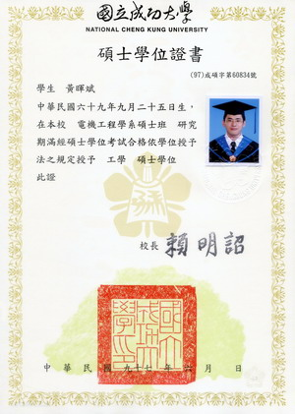
Why Research?
If you want to …
find something interesting
prove your Idea
write your thesis

Slide 4
Do research -> Publish paper
Not necessary
But, it is recommended if you want to …
attain project funding
announce your idea
polish your work
be famous
show who you are
graduate

Slide 5
What is Research?
Action > Result > Reason > Knowledge
To find a good research issue.
To design a method to solve it.
To make experiments.
To analyze experiments.
To construct the novel knowledge by yourself.
A research should have its
novelty
uniqueness
contribution
re‐doable / soundness

Slide 6
What is Research?
A research could be…
Solving a problem never be solved
Telling a new problem never be found
Finding an interesting idea to solve the old problem
Finding a better method than before

Slide 7
What is a “Good” research?
A good research should have its
novelty (to lead a new research topic)
uniqueness (to show something others can’t show)
contribution (to impact other researches)
re‐doable (to lead more citation and comparison)

Slide 8
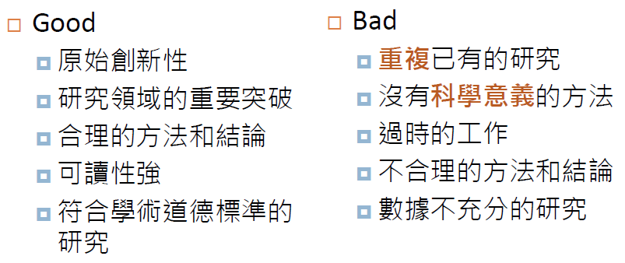
What is a “Good” research?

Slide 9
How to be an expert in a new domain?
Read a paper
Read more papers
Read more and more papers
But you should learn how to select the useful papers!
To know the research fields of your research issue.
To know the high quality resource of your research issue.
Conferences (Novelty – New Idea, Popular issues.)
Journals (Complete works)
To read papers and make your own good references.

Slide 10
How to find useful papers?
If you don’t know the keywords in English…
find related papers in Chinese and record the keywords
ask google
If you don’t know the research field of your issue…
http://www.wikicfp.com/ Key in your keywords
Look for scope/issues of related conferences.
High quality resource
Top conferences
SCI/SSCI Journals
http://admin-apps.webofknowledge.com/JCR/JCR (Only access in academic IP domain.)

Slide 11
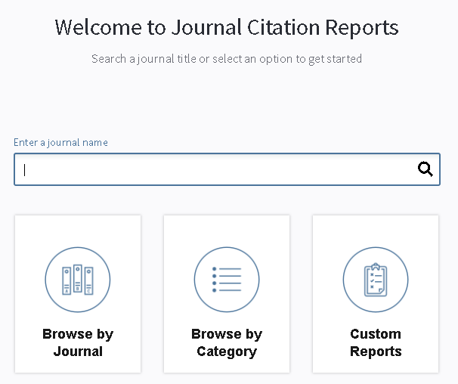
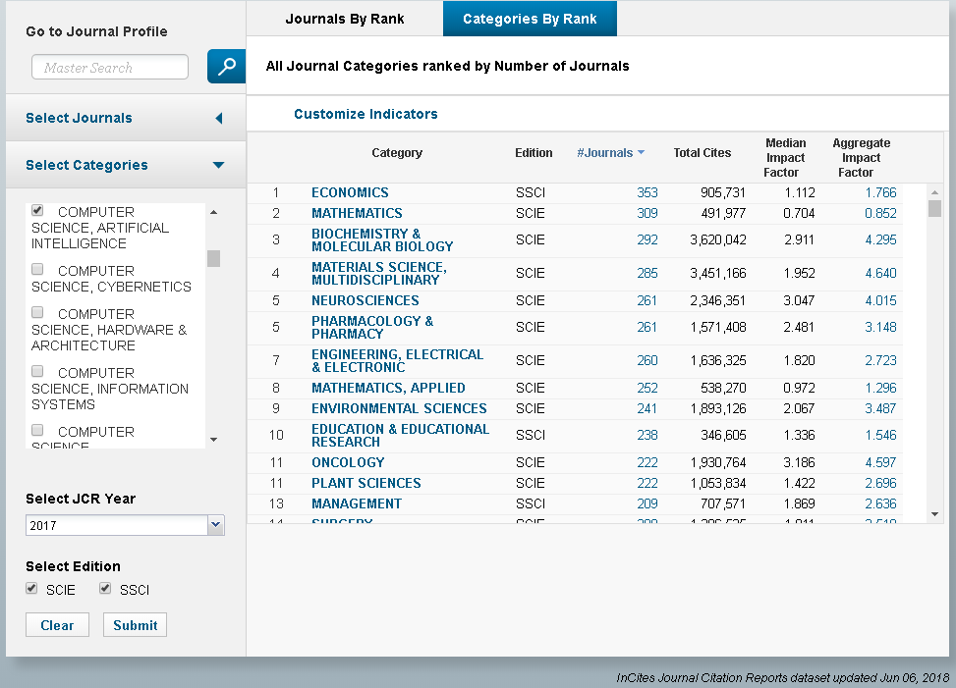
How to find useful papers?

Slide 12
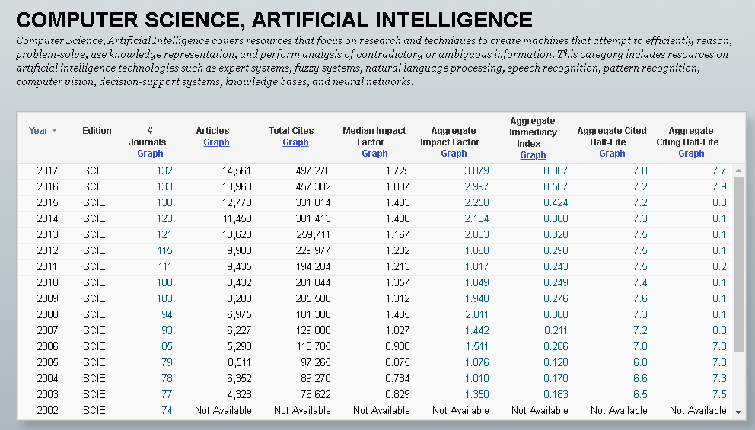
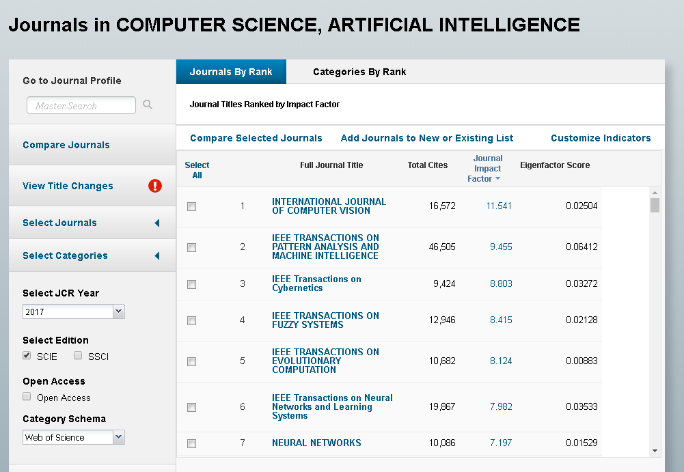
How to find useful papers?

Slide 13
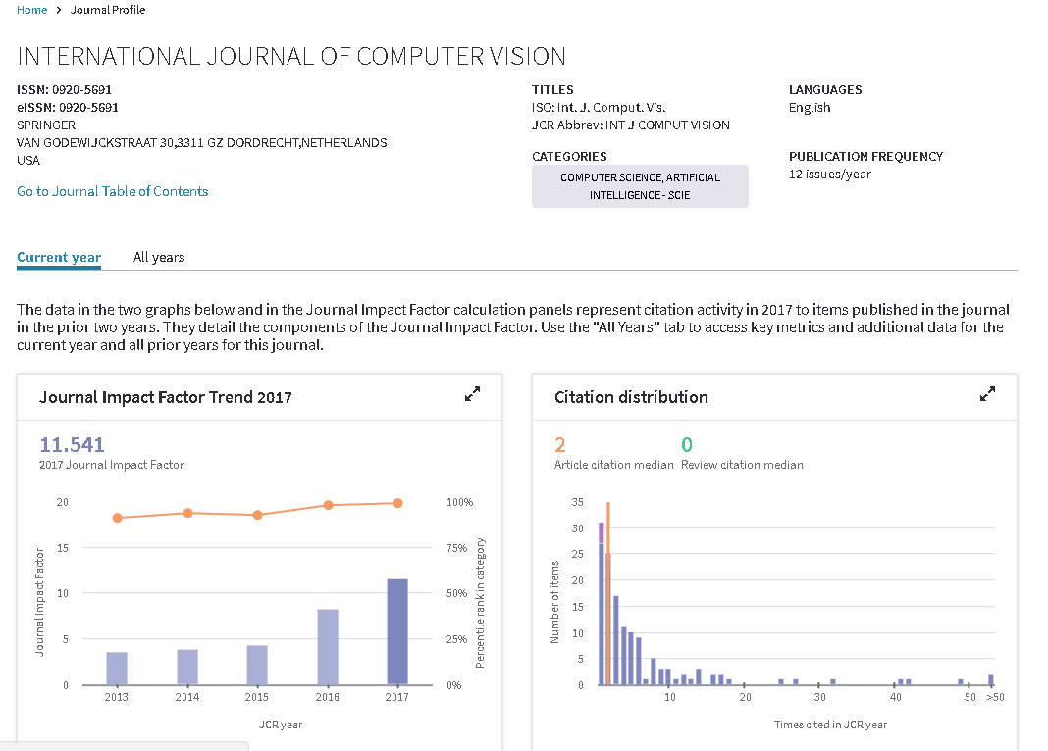
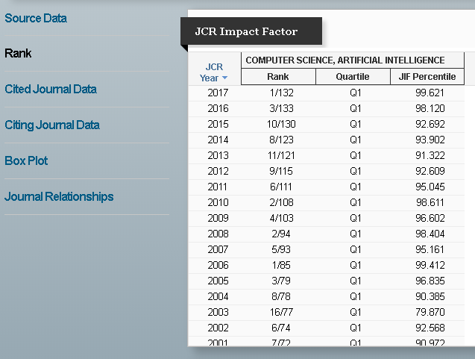
How to find useful papers?

Slide 14
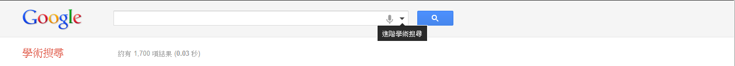
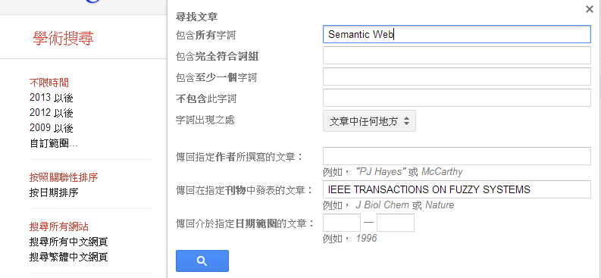
How to find useful papers?
http://scholar.google.com.tw/

Slide 15
First Practice
Find two papers that related to your research issue.
The one is top conference paper and limitation of 2017-2018.
Another one is journal paper which is SCI/SSCI of Q1.
Report in next time
只能看conference paper的題目, 虛構出此篇論文的各章節內容來報告!
10 mins

